Slide 1
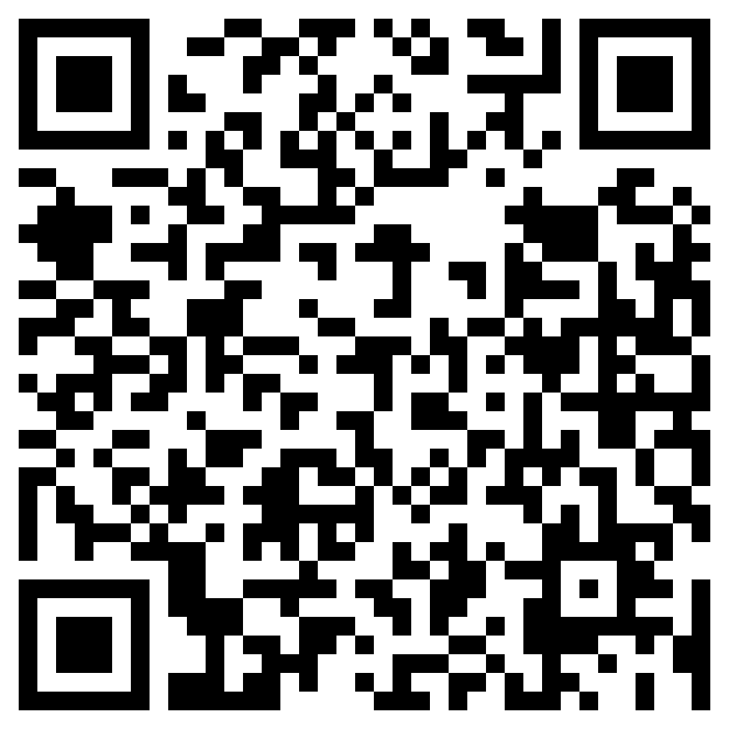

Unlocking Career Opportunities in Germany
Join PSA-KA Organized Workshop: "Unlocking Career Opportunities in Germany" Are you looking to secure jobs or internships in Germany? Join us for an insightful workshop where we'll cover essential strategies and tips to help you succeed in the German job market.
Workshop Highlights:
Understanding the German job market
Crafting a winning German-style resume (CV)
Effective job search techniques
Navigating the internship landscape
Interview/Job and networking skills
Don't miss this opportunity to boost your career prospects in Germany.
Secure your future in the German job market - we look forward to helping you achieve your career goals!
Date: 15.10.2023
Time: 15:00 CET
Meeting Link: https://kit-lecture.zoom-x.de/j/66444396336?pwd=WE5MRCtKQktEWTRKcFZYUGg5aHBsdz09
Join Zoom Meeting

